Slide 1
Performance Measures in Project Management
Performance Indicators
Performance Improvement
Project Management & Environment

Slide 2
Project may be considered a total failure if:
It is abandoned half-way or kept in abeyance or completed with a changed concept
It does not produce as specified in terms of quality of produce
It becomes sick soon after going into commercial production
Most projects fall in between a total success or a total failure

Slide 3
Performance Indicators
Cost over run and time over run
These do not enable any comparison with another project
Do not convey whether time and cost targets were unrealistic
A well managed project may have time and cost over-runs

Slide 4
Time Over-run
Schedule quoted can be far from realistic
Vendors and contractors commit unrealistic delivery time
Defective design and subsequent modification / change to suit the project’s requirement increases cost and time
How much time a project actually takes ?
Who is responsible for the over-runs?
Time over-runs cannot be used as true indicators for project management performance

Slide 5
Cost Over-run
Time can be misquoted, cost cannot
Any mismanagement will increase cost
Cost can be used as an indicator for project management performance
Cost estimates are to be revised at various stages to improve their accuracy – costs increase after each revision
Cost over-run, the expression which is used to represent the variance between the original sanctioned cost and the final cost incurred, would then provide no indication of managerial performance

Slide 6
Project Sickness
An efficient project manager must make the best possible use of the resources given to him for achieving the project objectives
A successful project must produce a saleable output
The ratio of this output to the cost incurred for setting put the plant, could be an indicator of project management performance
Performance of the plant is also dependent on the quality of project management

Slide 7
Quality of plant and equipment will decide the cost of utilities, repair and maintenance
Depreciation
If production cost and installed cost are not managed well a project may fall sick
It may fall sick because of mismanagement of activities during commercial operation
Installed cost per capacity is a performance indicator

Slide 8
Productivity as Performance Indicator
Productivity indicator reflects how resources have been utilized either for production of goods and services or for creation of facilities
Productivity at implementation stage will affect the productivity of an operating plant
Ensure profitability of the plant and ward off sickness
A ratio of budgeted and actual expenditure is always a better indicator of performance than deviation figures between budget and actual cost.

Slide 9
A ratio of installed cost to completion time can be a better index which can be used to reflect project management’s performance
Computing cost index and schedule index of a completed project and comparing it with the industry average in the same technological area will give a true indication of PM performance
Value as Performance Indicator
Limitless excellence, without any consideration of time and cost, can lead to project disaster

Slide 10
Task of PM is to
build a project that works
To define time-cost-performance frame work and then to ensure, through design of the hardware and management of its implementation
The scope-time-cost-performance diagram is a symbolic representation of scientific project management and can make a good design for a project management logo
When the cost of a project is controlled, scope, time, performance are also controlled

Slide 11
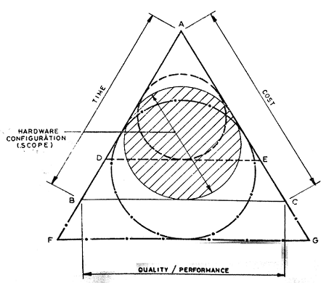
Legend:
A B C- Normal Scope & Frame Work
A F G – Enlarged Scope & Frame Work
A D E – Reduced Scope & Frame Work
Project Management Logo

Slide 12
Value engineering encourages increase in quality if it can be attained at no extra cost
Performance Improvement: Do-it-Yourself Trap
Imposes tremendous load of coordination
Lack of experience of working in an uncertain and dynamic environment
Not equipped with the tools and techniques of PM
Leads to cost and time overruns
Unnecessary expansion of scope
Inability to handle vendors

Slide 13
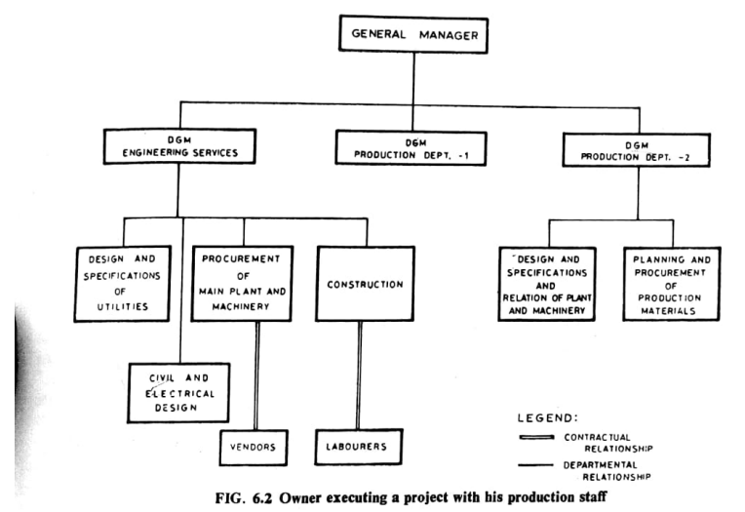

Slide 14
The Turn-key Trap
Schedule or cost quoted by the turn-key contractor should be of secondary consideration
Contractor’s track record in managing projects
He will make the tightest possible design and may compromise with quality to earn profit
Legal consequences may prop up if not handled properly

Slide 15
Project Management Environment
PM performance largely depends on the real- world environment
PM environment in India is shown in figure
Problems specific to country
Lack of mutual trust and respect amongst the stakeholders: owners, financial institutions, consultants, vendors & contractors
Traders-turned entrepreneurs or financers handling projects
Introduction of on going audit system

Slide 16
Financial institutions may not trust the owner/ promoter since an owner may disown a project and the financial institutions have more stake in the project than the owner himself
Promoter may intentionally underestimate the project cost with the intention of reducing his contribution
Most vendors and contractors may not trust the owner regarding payment
Financing cost and inflation overtake the revised cost estimate

Slide 17
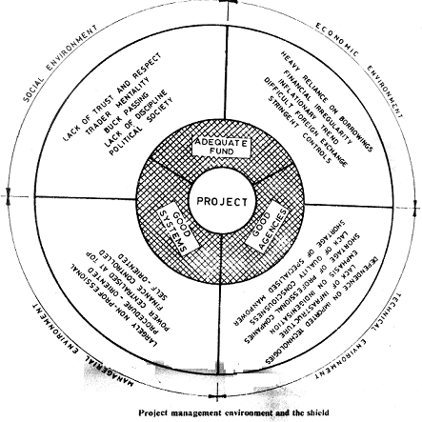

Slide 18
Risk Analysis
Sources, measures, and perspectives of risk
Sensitivity analysis
Scenario analysis
Break-even analysis
Hillier model
Simulation analysis
Decision tree analysis
Managing risk
Project selection under risk
Risk analysis in practice

Slide 19
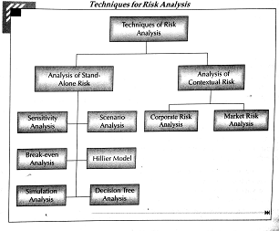

Slide 20
Sources of Risk
Project-specific risk
Competitive risk
Industry-specific risk
Market risk
International risk
Measures of Risk
Risk refers to variability
Range, Standard Deviation, Coefficient of variation, and semi-variance

Slide 21
Standard Deviation is the most widely used measure of risk because:
If a variable is normally distributed, its mean and standard deviation contain all the information about its probability distribution
If the utility of money is represented by a quadratic function, , then the expected utility is a function of mean and std. deviation
Standard deviation is analytically easily tractable

Slide 22
Subjective Probabilities
Objective evidence may not be available for defining probability distribution
Probability distribution is defined based on experience and judgment
Perspectives on Risk
Stand-alone risk- Project viewed in isolation
Firm risk or Corporate risk - Contribution of a project to the risk of the firm
Systematic risk or market risk – Risk of the project from the point of view of a diversified investor

Slide 23
Stand alone Risk – Advantages
Easier to measure
In most of the cases, stand-alone risk, corporate risk and market risk are highly correlated
The proponent of capital investment is likely to be judged on the performance of that investment
In most firms, the capital budgeting committee considers investment proposals one at time

Slide 24
Sensitivity analysis
To know the viability of the project when some variable like sales or investment deviates in future from its expected value
Sensitivity analysis means varying the inputs to a model to see how the results change
Sensitivity analysis is a very important component of exploratory use of models
model is not regarded as “correct”
sensitivity analysis helps user explore implications of alternate assumptions
human computer interface for sensitivity analysis is difficult to design well
In many models we need to make assumptions we cannot test
Sensitivity analysis examines dependence of results on these assumptions

Slide 25
Sensitivity Analysis
Sensitivity Analysis Answers the question:
What does make a difference in the decision?
Determining what does matters and what does not requires incorporating sensitivity analysis throughout the modeling process.
No optimal sensitivity analysis procedure exist for decision analysis: Model building is an Art!

Slide 26
Sensitivity Analysis
The question that we ask performing SA is: Are we solving the right problem?
Type III Error: implies that the wrong question was asked or inappropriate decision context was used.

Slide 27
One Way Sensitivity Analysis
What variables really make a difference in terms of the decision in hand?
Do different interest rates really matter?
Does it matter that company can set the ticket price?
Hours Flown how much impacts on the profit?

Slide 28
Two way sensitivity Analysis
Suppose we wanted to explore the impact of several variables at one time.
A graphical technique is available for studying the interaction of two variables.
For example suppose we want to consider the joint impact of changes in the 2 most crucial variables( Operating cost and Capacity of scheduled flights)

Slide 29
Evaluation and merits of sensitivity analysis
It shows how robust or vulnerable a project is to changes in values of the underlying variables
It indicates where future work may be done. If the net present value is highly sensitive to changes in some factor, it may be worthwhile to explore how the variability of that critical factor may be contained
It is intuitively a very appealing as it articulates the concerns that project evaluators normally have

Slide 30
Drawbacks of Sensitivity Analysis
It merely shows what happens to NPV when there is change in some variable, without providing any idea of how likely that change will be
Only one variable is changed at a time. In practical multiple variable move together
Very subjective analysis. Same analysis may lead one decision maker to accept the project while another may reject

Slide 31
Scenario Analysis
For interrelated variables, some plausible scenarios are to be looked into
Each scenario should represent a consistent combination of variables
Procedure
Select the factor which is the largest source of uncertainty for the success of the project, around which scenarios will be built. Ex: state of the economy, interest rate, technological development, response of the market

Slide 32
Estimate the values of each of the variables in investment analysis ( investment outlay, revenues, costs, project life, and so on) for each scenario
Calculate the net present value and/or internal rate of return under each scenario
Best and Worst Analysis
Best Scenario – Ex. High demand, high selling price, low variable cost, etc
Normal Scenario – Ex. Average demand, average selling price, average variable cost, etc
Worst Scenario – Ex. Low demand, low selling price, low variable cost, etc

Slide 33
It’s an improvement over sensitivity analysis because it considers variables together
Limitations
Based on assumption that there are few well-delineated scenarios
When a continuum is converted into several discrete states, some information is lost
It expands the concept of estimating the expected values

Slide 34
Break-Even Analysis
A break-even analysis is a calculation of the point at which revenues equal expenses. In securities trading, the break-even point is the point at which gains equal losses
Accounting Break-even Analysis:
Return of original investment but not compensated for the time value of money or the risk taken
Opportunity cost of the capital is lost
Will have a negative NPV

Slide 35
Financial Break-even Analysis:
Focus is on NPV and not on accounting profit
Financial BeP is significantly higher than Accounting BeP
Amount of sales to have a zero NPV
Hillier Model
H.S. Hillier suggested analytical derivation of the expected NPV and Standard deviation of NPV

Slide 36


Uncorrelated Cash Flows: Cash flows of different years are uncorrelated.
Where = expected net present value
= expected cash flow for year t
i= risk free interest rate
I = Initial outlay
= standard deviation of NPV
σ_{t} =standard deviation of the cash flow for year t

Slide 37

Perfectively Correlated Cash Flow:
The behavior of cash flows in all periods is alike
If the actual cash flow in one year is α standard deviations to the left of its expected value, cash flows in other years will also be α standard deviations to the left of their respective expected values
Cash flows of all years are linearly related to one another

Slide 38
Simulation Analysis:
Information generated by simulation analysis may be used for developing the probability profile of a criterion of merit by randomly combining values of variables which have a bearing on the chosen criterion
Procedure:
Model the project: shows how the NPV is related to parameters and the exogenous variables
Specify the values of parameters and the probability distributions of the exogenous variables

Slide 39
Procedure contd..
Select a random value from the probability distributions of each of the exogenous variables
Determine the NPV corresponding to the randomly generated values of exogenous variables and pre-specified parameter values
Repeat steps (3) and (4) to get a large number of simulated NPVs
Plot the frequency distribution of the NPVs

Slide 40
Obtaining Probability Distributions of Basic Variables
Defining probability distribution is the basic and most important step in simulation
Often it is impossible to find the true distribution
Based on judgment of experts
Certain software packages help to select a right distribution

Slide 41
Obtaining Probability Distributions of Basic Variables
Portrait Approach:
Statistician draws up a standard probability distribution on the basis of the judgment expressed by the expert
Drawback: The expert may accept a smooth distribution because s/he may be beguiled (deceived) by the appearance of smooth curves and complicated formulae

Slide 42
Building Block Approach:
Probability distribution is defined by the expert
Procedure:
Chooses the range encompassing possible values
Divides the range into intervals which s/he thinks have different probabilities associated with them
Assigns probabilities to these intervals and sub-intervals
Continues this process till s/he arrives at a distribution which represents his/her judgment well

Slide 43
Some commonly used distributions:
Uniform
Trapezoidal
Step rectangular
Normal

Slide 45
Issues in Applying Simulation
What should the output be?
Is project variability enough?
How would the extreme values be used?
How should the results of simulation be used?

Slide 46
Advantages
Versatility
It compels the decision maker to explicitly consider the interdependencies and uncertainties characterizing the project
Shortcomings
Difficulty in modeling the project
Inherently imprecise
A realistic simulation model which is usually complex, may be difficult to understand for the decision maker

Slide 47
Decision Tree Analysis:
To analyze situations where sequential decision making in the face of risk is involved, decision tree analysis is a useful tool.
Key Steps:
Identifying the problems and alternatives
Delineating (identifying & indicating the exact position)the decision tree.
Specifying probabilities and monetary outcomes
Evaluating various decision alternatives

Slide 48
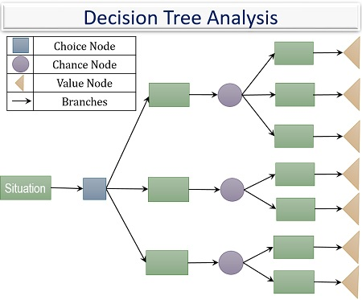
www.theinvestorsbook.com

Slide 49
What types of projects can be analyzed using decision tree?
Projects with the following characteristics can be analyzed:
Decisions on continuing the project are made in well-defined stages
The outcomes at each stage fall into few broad classes
The probabilities and the cash flows associated with various outcomes can be specified at the beginning of the project.

Slide 50
Decision tree analysis requires enormous information before it can be applied
Difficult to apply for new projects where the organization has very limited information about the project
Difficult to apply when investments are gradually made over a period of time rather than in a few well-defined stages.

Slide 51
Managing Risk
Fixed and variable costs
Pricing strategy
Sequential investment
Improving information
Financial leverage
Insurance
Long-term arrangements
Strategic alliance
Derivatives : Options and future

Slide 52
Project Selection Under Risk
Judgmental Evaluation
Payback Period Requirement
Risk adjusted discount rate method

Slide 53
References
Project Management: Choudhry S., Tata McGraw-Hill, 2010
Projects: Planning, Analysis, Financing, Implementation, and Review - Prasanna Chandra, 5th edition, Tata McGraw-Hill publishing company limited, 2005
Project management a system approach to planning scheduling and controlling- Harold Kerzner, CBS Publisher and distributors, 2002.
A management guide to PERT and CPM- WEIST and Levy Eastern Economy of PH 2002.
T R Banga, N K Agarwal and S C Sharma -Industrial engineering and Management Sciences, -Khanna Publishers

Slide 54
Thank You

